Slide 1
TYRE PRESSURE MONITORING SYSTEM
PIP2001 Capstone Project
Final Review
Batch Number: CIT-G13
Roll Number | Student Name
Under the Supervision of,
Dr.Mohana S D.
Professor
School of Computer Science and Engineering
Presidency University
20211CIT0134 | RANJAN M B
20211CIT0133 | MANISH
20211CIT0030 | SHREEJITH SHETTY S
20211CIT0138 | HARSHA VARDHAN P
Name of the Program: Computer Science and Engineering (IOT)
Name of the HoD: Dr. Ananda RaJ
Name of the Program Project Coordinator: Ms.Sterlin Minish T N
Name of the School Project Coordinators: Dr. Sampath A K / Dr. Abdul Khadar A / Mr. Md Ziaur Rahman

Slide 2
Content
Problem Statement
Github Link
Analysis of Problem Statement
Timeline of the Project
Output (Images)
References

Slide 3
Problem Statement Number:
Organization: Bridgestone
Category (Hardware / Software / Both) : Both
Problem Description : Challenge to monitor the tyre inflation pressure. Large fleets having >100 vehicles extremely difficult to manage tyre maintenance/labor cost. Solution required:- Automotive sensors showing real time inflation pressure through digital platform.
Difficulty Level: COMPLEX

Slide 4
Github Link
ROLL NO | GITHUB LINK
1. 20211CIT0030 | https://github.com/Shreejith30
2. 20211CIT0138 | https://github.com/HarshaVardhan138/Capstone-project-.git
3. 20211CIT0133 | https://github.com/manishadekar
4. 20211CIT0134 | https://github.com/Ranjan-mb

Slide 5
Analysis of Problem Statement
Technology Stack Components:
Component | Technology/Tools
Pressure Sensors | XGZP168 Pressure Sensor
Microcontroller | ESP32
Firmware | C/C++ with sensor drivers , Kotlin
RF Communication | WIFI
In-Vehicle Display | LCD screen , Android App
Cloud | Firebase
Mobile App | Android Studio
Database | Firebase(Real Time Database
Apllications | Android Studio , Firebase , Arduino Ide

Slide 6
Analysis of Problem Statement (contd...)
Hardware Requirements :
Pressure Sensor(XGZP168)
ESP32
I2C Module , LCD Display
Battery , Charging Module
Bread Board
USB Cable
Jumper Wires , Charging case

Slide 7
Analysis of Problem Statement (contd...)
2. Software Requirements :
Programming Languages (C++ , Kotlin )
Sensor Drivers
WIFI Communication Protocols
Mobile Application(Andoid Studio)
Backend (Firebase)
Arduino Ide

Slide 8
Timeline of the Project (Gantt Chart)
19-Sep-24
9-Oct-24
29-Oct-24 18-Nov-24 8-Dec-24 28-Dec-24 17-Jan-25
Requirement Analysis 11
Planning and Design
29
Development
30
Testing
19
Deployment
12
Maintenance
7

Slide 9
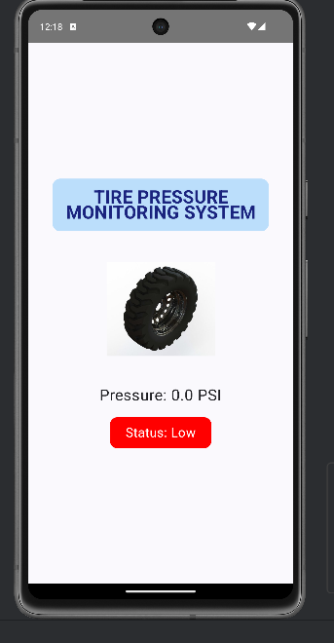
Mobile Application UI

Slide 10
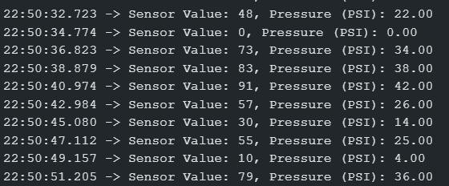
Sensor Outputs

Slide 11
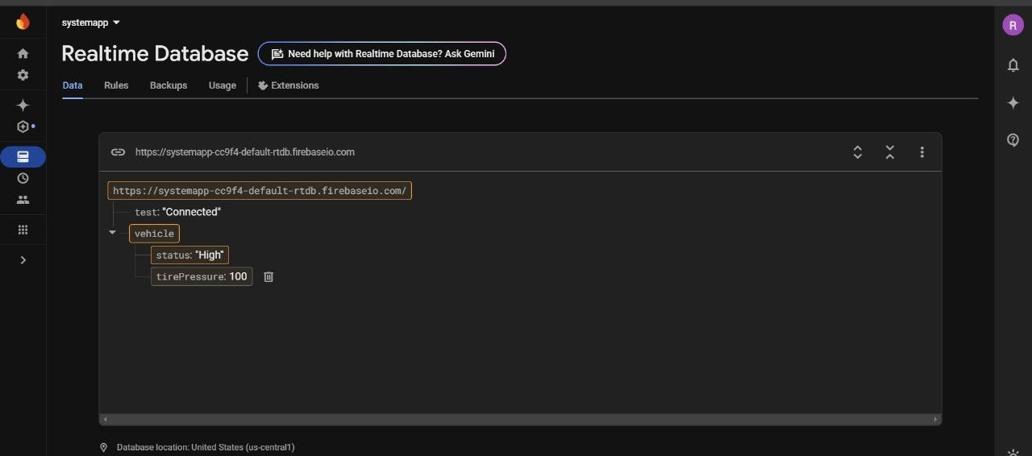
FireBase

Slide 12
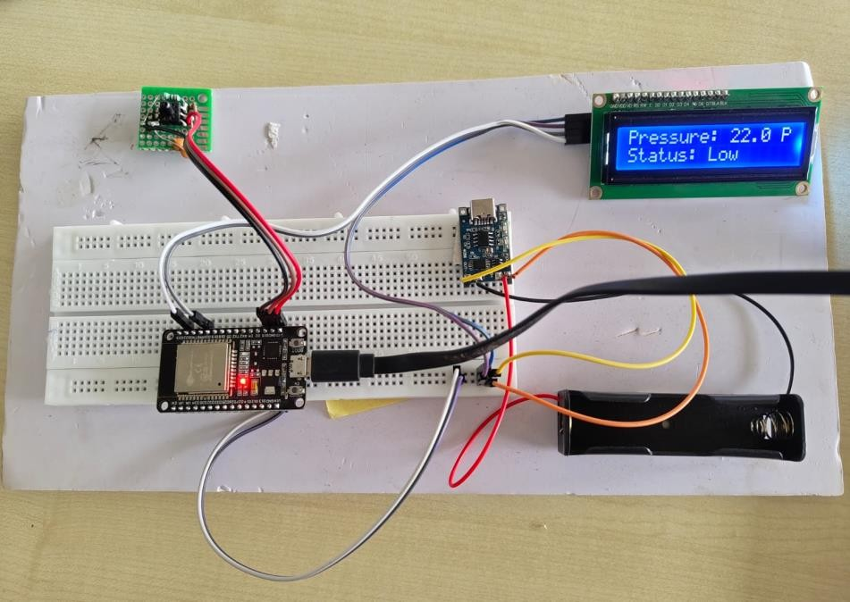
Hardware Setup

Slide 13
References (IEEE Paper format)
[1] TIRE PRESSURE MONITORING SYSTEM USING WIRELESS COMMUNICATION, (IJSRMS) ISSN: 23493771 Volume 2 Issue 2, pg:105-111.
[2] Stephan van Zyl, Sam van Goethem, Stratis Kanarachos, Martin Rexeis, Stefan Hausberger, Richard Smokers, Study on Tyre Pressure Monitoring Systems, TNO-060-DTM-2013-02025, 29 July 2013.
[3] Muhammad Ali Mazidi, Rollin D. Mackinlay, PIC Microcontroller and Embedded systems Using Assembly and c, Danny Causey; Pearson International Edition .
[4] “Tire pressure Monitoring system, Hilmi Bin Mohd Zahidi (university Malaysia Pahang) [5] Data-sheet BMP180 Pressure Sensor &RF Transmitter & Receiver.

Slide 14


